Slide 1
Providing a Secure Base
When Nothing Else Feels Secure.
Re-opening our doors to the wider school community while supporting attachment needs and experiences of trauma and loss in adults and children.
Calderdale Virtual School

Slide 2
Definition of Trauma
“Trauma is an experience that disrupts our inherent physiological need for safety, relationships and a sense of belonging” Staci Haines
Your returning school community will each have experienced their own traumas and losses during this time and will continue to do so.
While we need to consider the physical practicalities of opening our doors wider, we ignore the emotional impact at our peril.

Slide 3
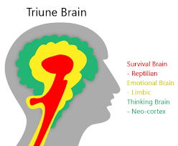
Image of French nursery playground from Twitter
We must be careful not to add further trauma. Remember; survival brain always trumps learning brain. Understanding the biology of stress will help us to have compassion and understanding in our decision making.
Click below to see children explain this further.
https://www.youtube.com/watch?v=eVhWwciaqOE

Slide 4
Safety
Belonging
Relationships
Secure Base
Success
Acceptance
Calderdale’s Secure Base Model

Slide 5
Adults First
The children will need the adults to feel and be, safe and well; physically and emotionally.
Stress is a contagion too.
How will you support staff well-being, including SLT?
What are your priorities at this time?
Safety
Relationships

Slide 6
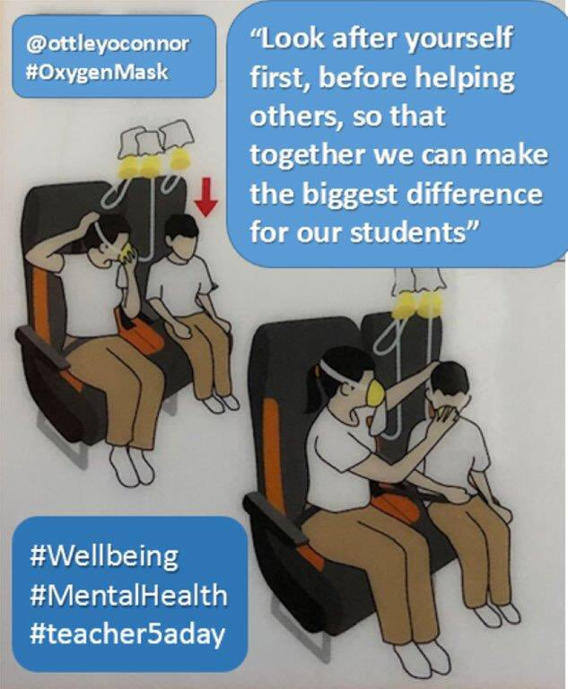

Slide 7
Then the Children
Provide time and space.
Provide routines and consistency.
Provide boundaries and natural consequences, delivered with supportive nurture.
Be curious and provide compassion and empathy.
The academic will come with time.
Safety
Relationships
Belonging

Slide 8
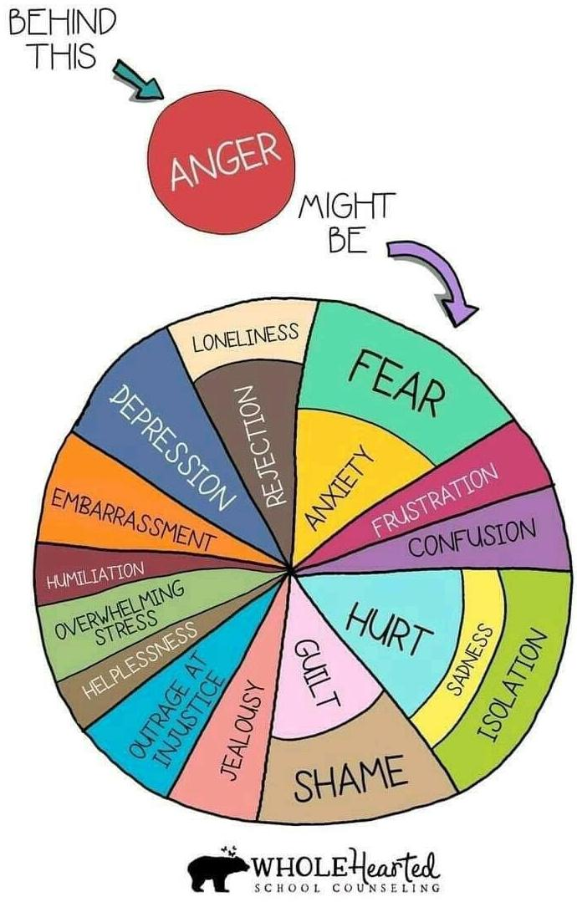
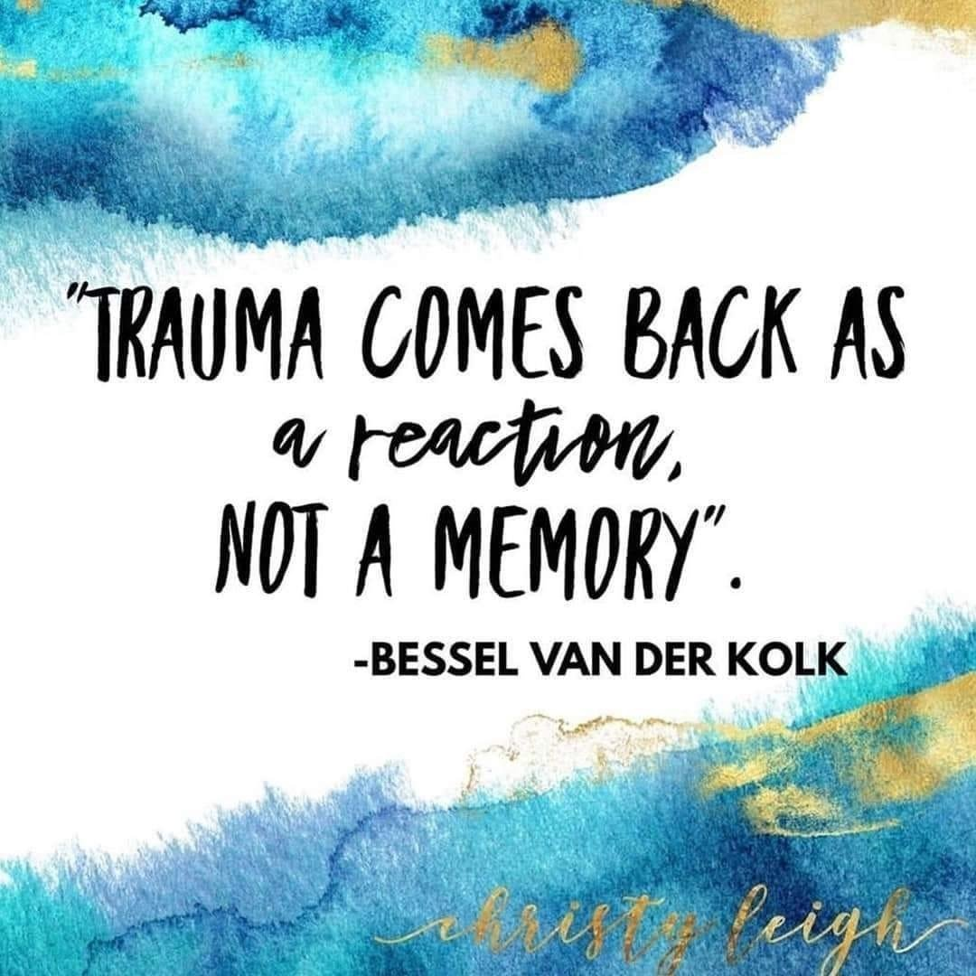
The behaviours that ‘show up’ may not be what you are expecting and you may need to look a little deeper than before.

Slide 9
Please Remember….
We have each experienced lockdown in different ways.
The way our brains and bodies function is a reflection of our experiences.
Toxic stress can lead to trauma responses i.e. behaviour.
Behaviour is always communicating something.
Positive relationships support healing and resilience.
Consistent routines and boundaries delivered with kindness support safety.
Start where you are, do what you can.
We are here to support you.

Slide 10
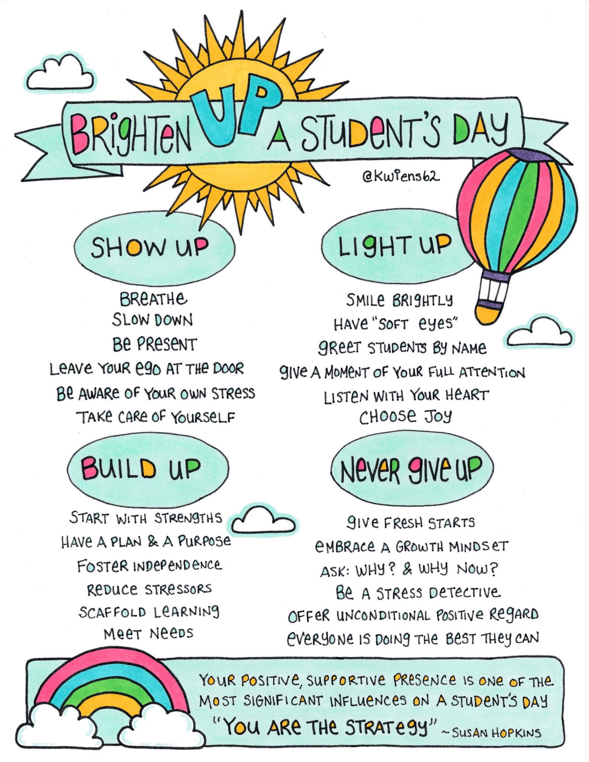

Slide 11
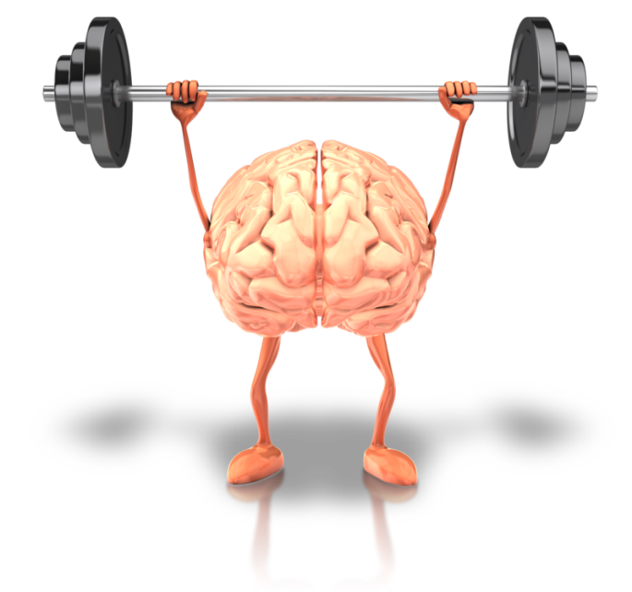
School Matters
This is a journey, not a destination. ☺
Further information available from Calderdale Virtual School.

